Slide 1
Work Content

Slide 2
Layout and Presentation
Layout Presentation (artwork must be kept) align all screens and presentation which is not all aligned.

Slide 3
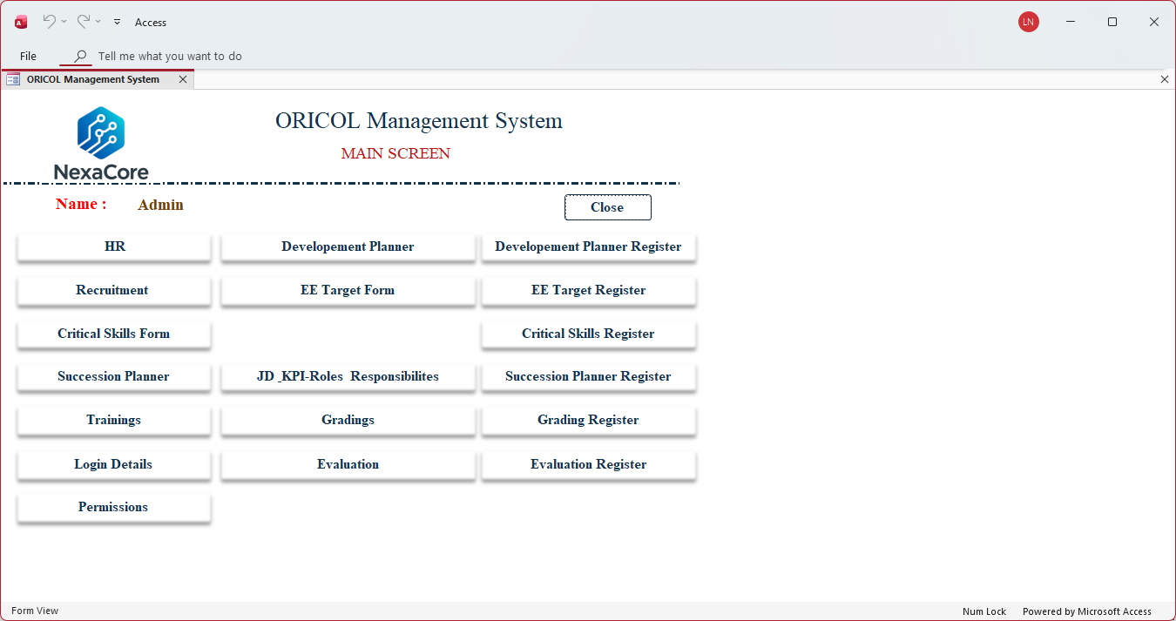

Slide 4
Please correct artwork
1.display style,
2.colour ,
3.font to original –
4.Names of tabs are sometime different to names of screen-
5.Spelling errors

Slide 5
Employee List

Slide 6
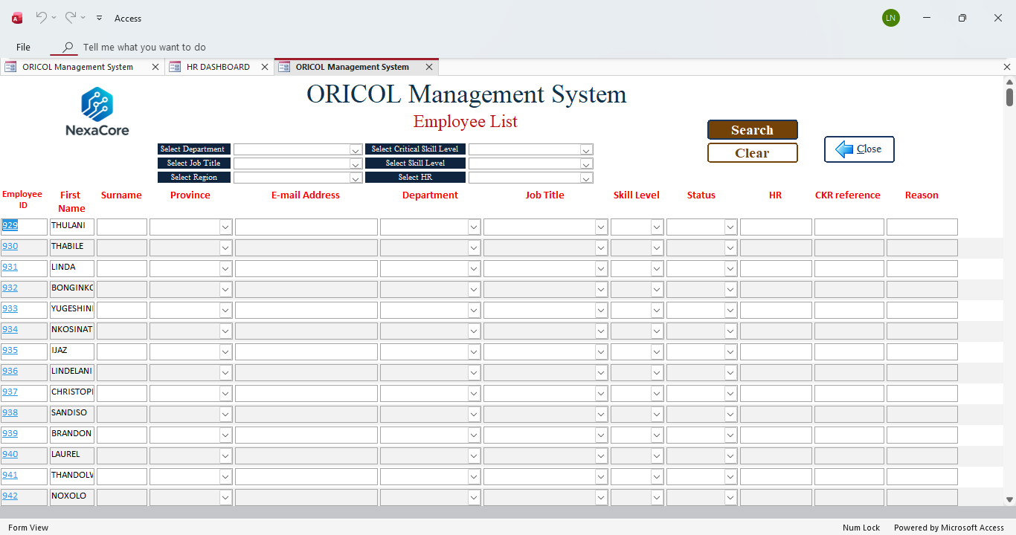
Filter by Employee not available and change red font to normal for all 12 column labels
Surname not pulling through from HR employee details

Slide 7
EE target register

Slide 8
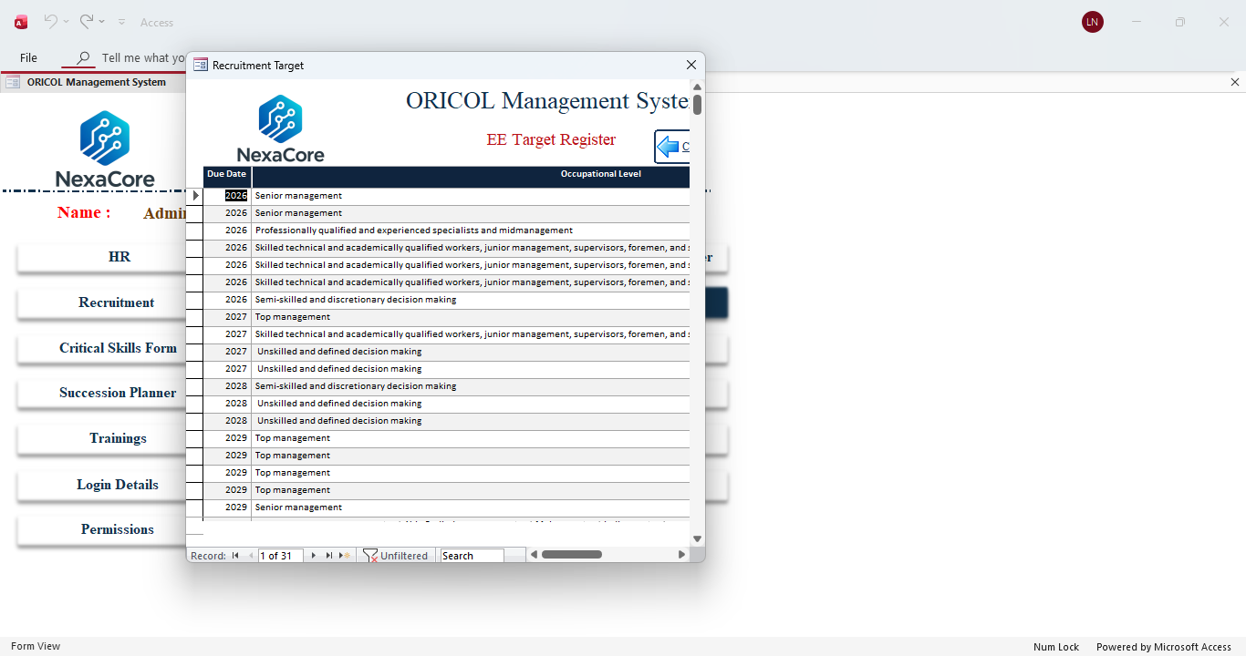
Screen not expanding, no max screen icon
Add filters for year, employment type, gender

Slide 9
Recruitment

Slide 10
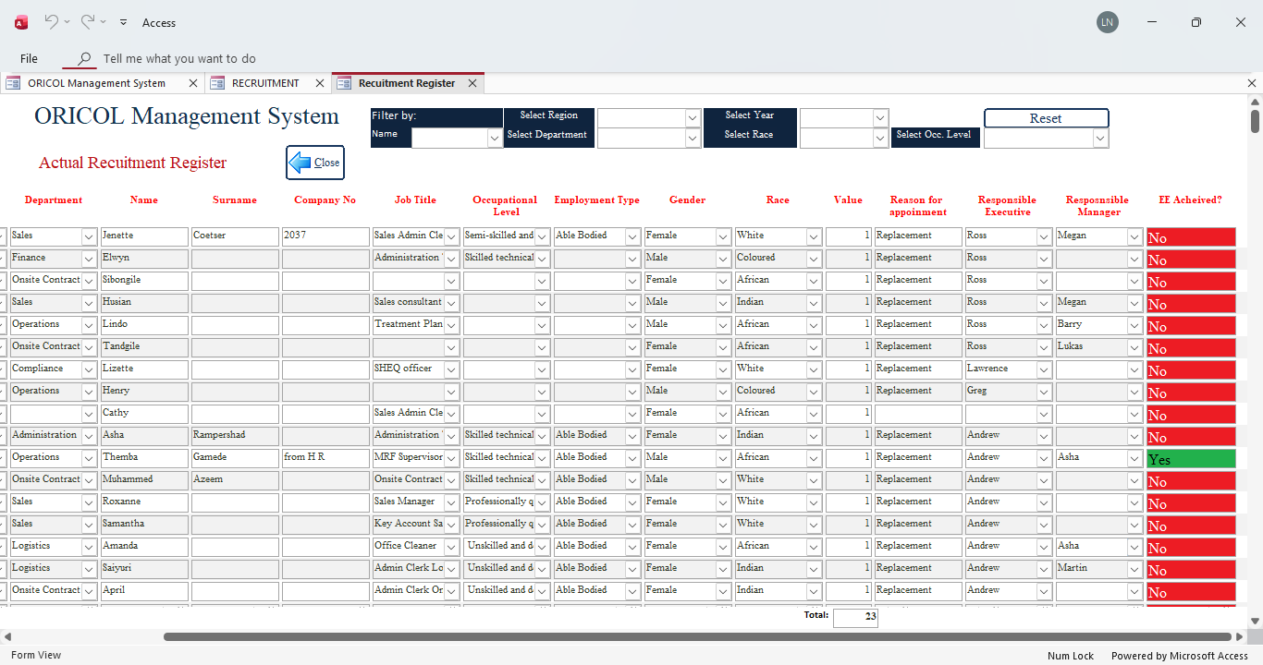
Add column - drop down for selection-
1. Insufficient Recruitment Opportunities:
2.Limited Promotion Opportunities
3. Shortage of Qualified Candidates from Designated Groups:
4. Mergers, Acquisitions, or Business Transfers
5.Legal or Regulatory Constraints
6. Economic Downturns or Financial Constraints
Allow to Upload Supporting documents-
Change RED font across all columns

Slide 11
Recruitment Interview Form

Slide 12
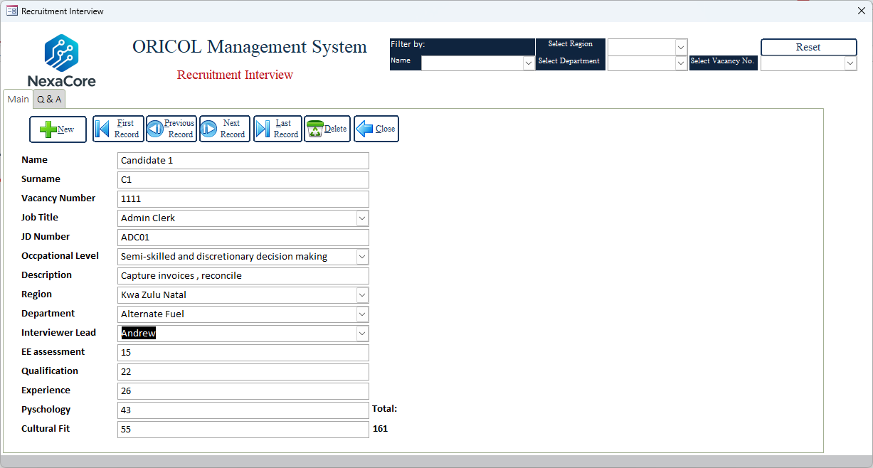
No save button
This should be a percentage- Total /Score – green for 50% and over and red 49 and below- same as register.

Slide 13
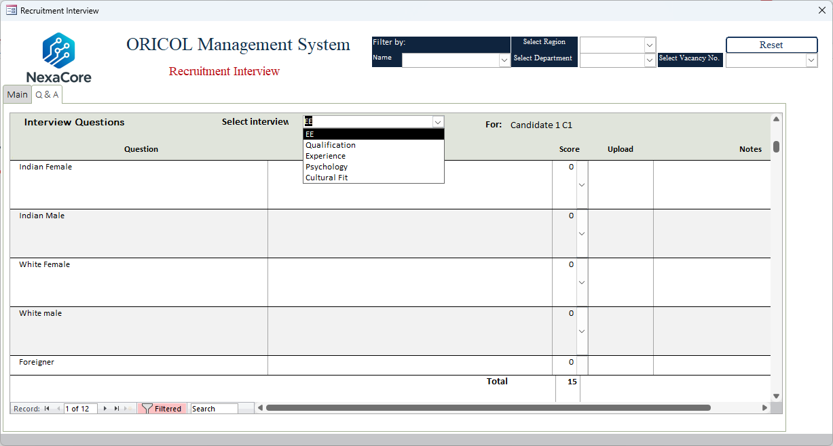
I Can't expand the screen- no maximize button
Change scoring-see next slide
No save or upload button BUT data pulls through.

Slide 14
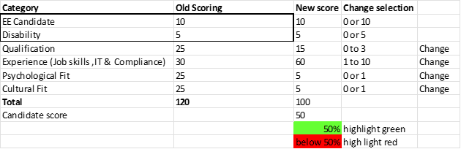

Slide 15
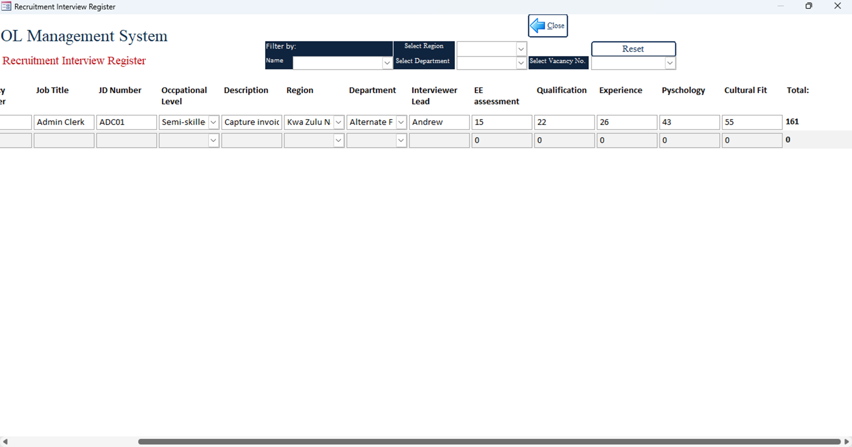
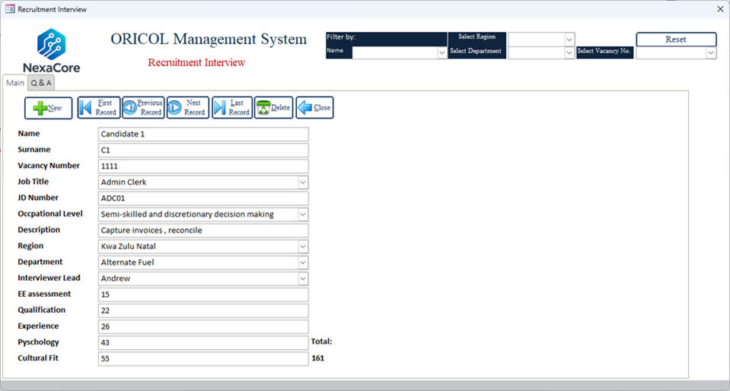
Mut show percentage 85/100- color code – below 49 red above 50 green
Add multiple selection names to tick
Percentage to appear in both form and register –
rules if 50 and over- green highlight and 49 below red

Slide 16
Request for Recruitment

Slide 17
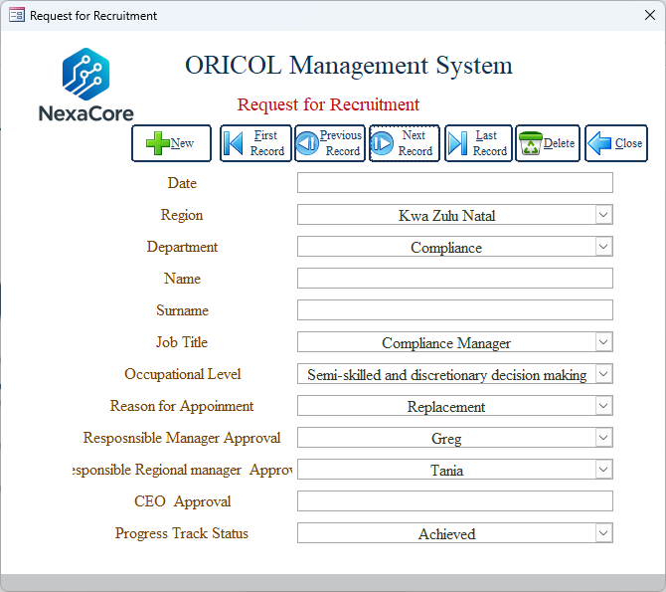
Date Picker missing
Re label to (Requestor Name) Remove Surname
Rename (Head office Approval
Remove -
Remove -This is in the register

Slide 18
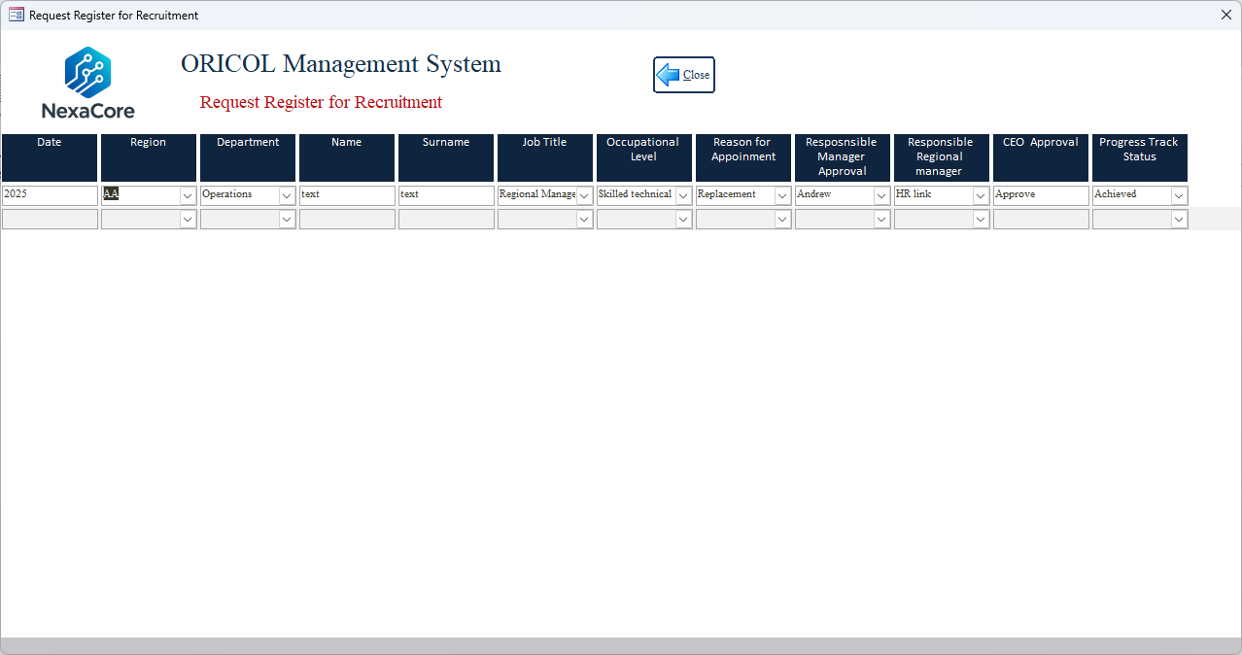
Request for recruitment -Register not opening fully – no maximize button
Rename (Head office Approval
As in the form
delete
Colour code (green) achieved, achieved replaced (blue) and last one (red)not achieved –not appointed.

Slide 19
Critical Skills form

Slide 20
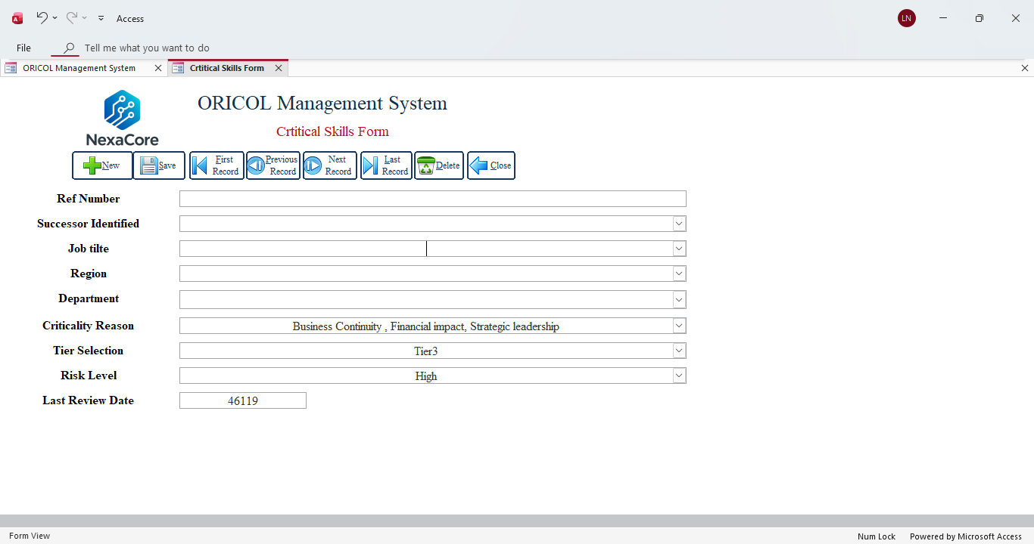
Text field- can't use (1, 2 ,3 ) unless jointed with multiple mixed with alphabets
This drop down (department) not allowing me to select

Slide 21
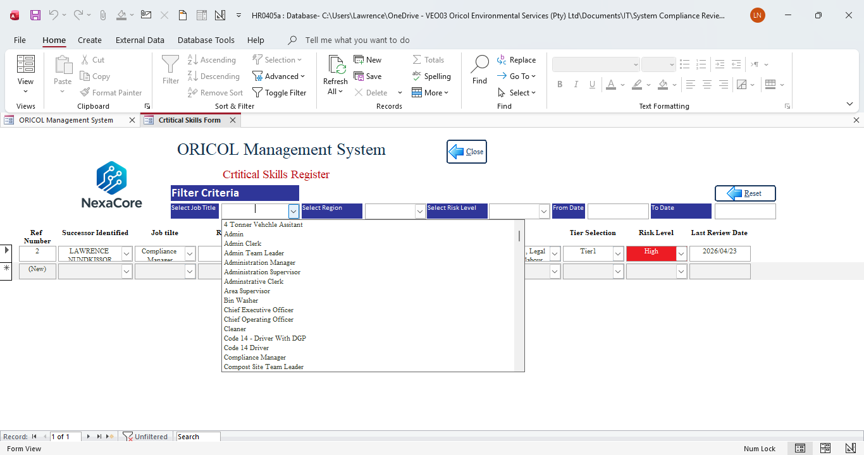
Incorrect colour
All Search must be in this register, this is incorrect

Slide 22
Succession Plan

Slide 23
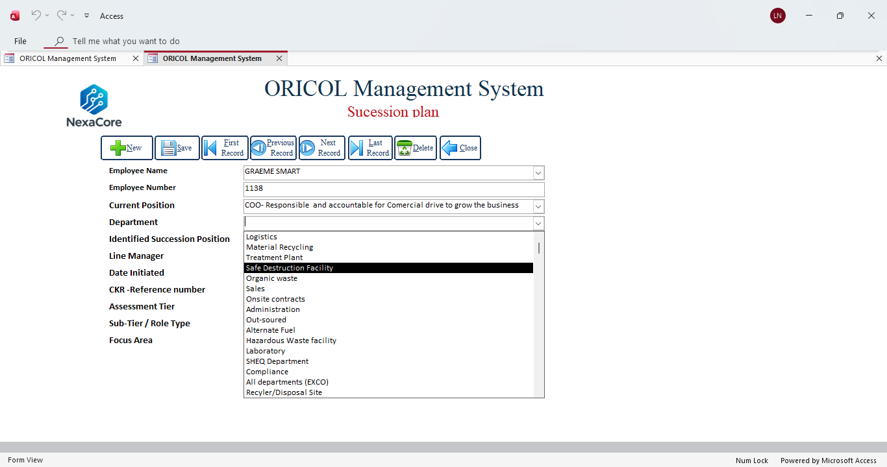
Not allowing to select department

Slide 24
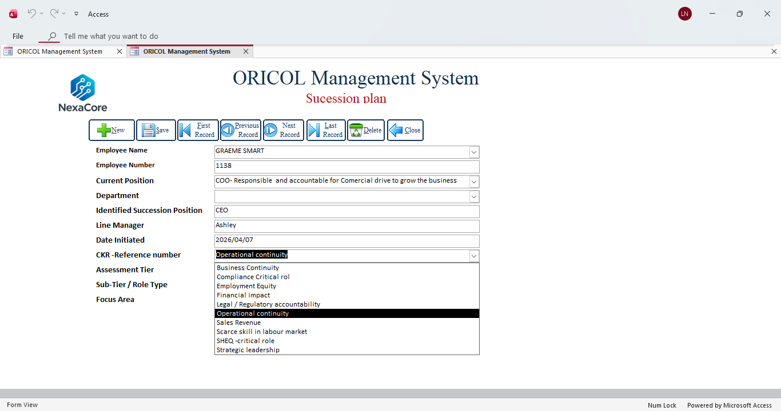
A drop down of Job titles must be added
A drop down of names must be added
CKR Reference number text or auto generate, there must be a link from the critical list connect a drop down

Slide 25
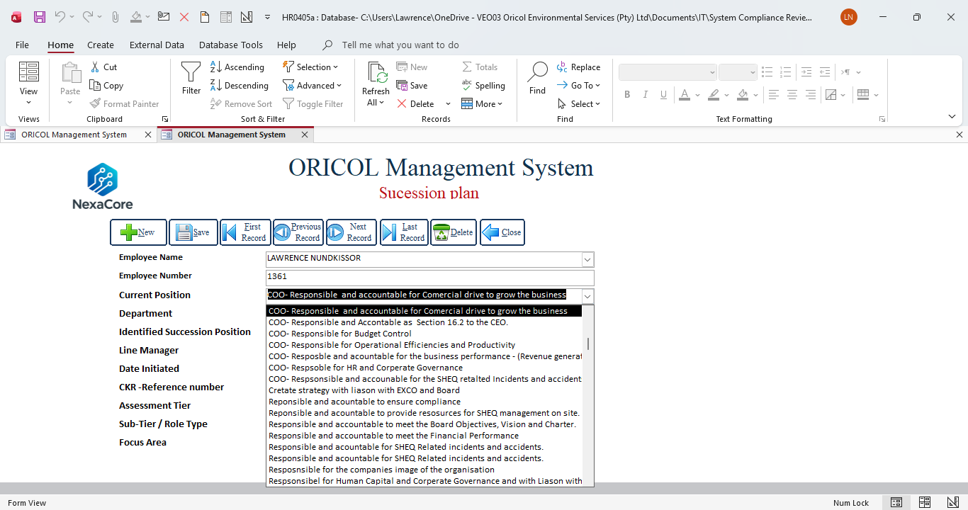
Pull job title for selection- this is incorrect

Slide 26
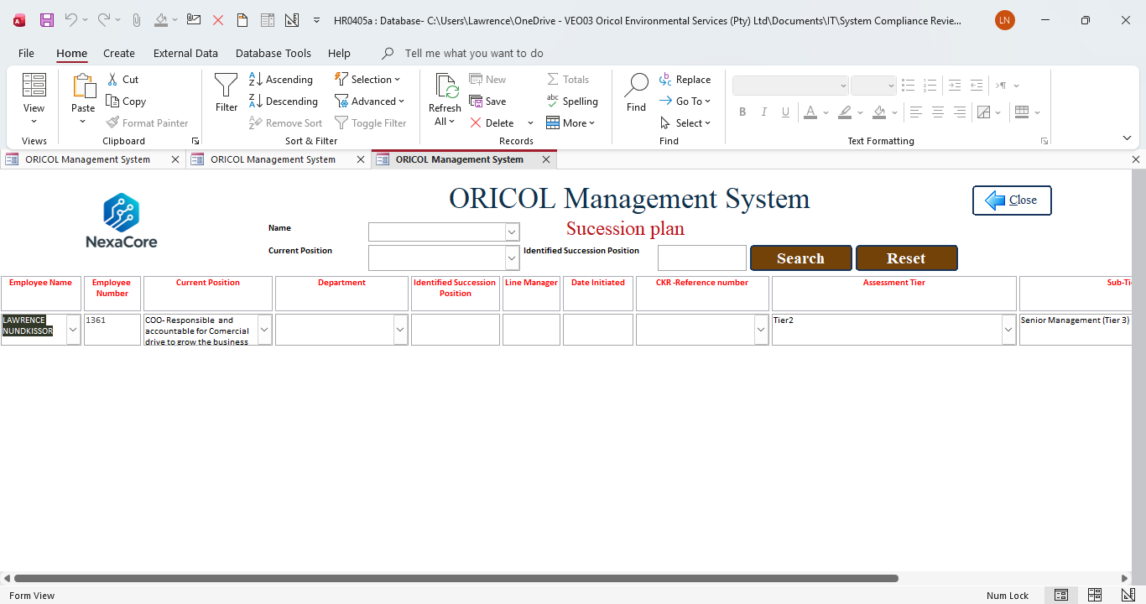
Label color code
Font colour incorrect

Slide 27
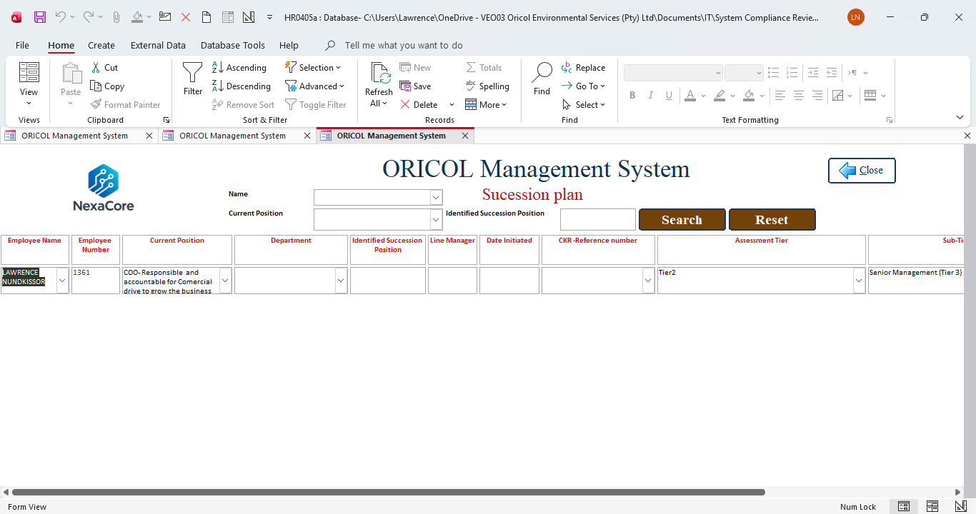
Adjust screen size.
Currently pulling incorrect data
Must only pull data that is captured

Slide 28
Grading Form and register

Slide 29
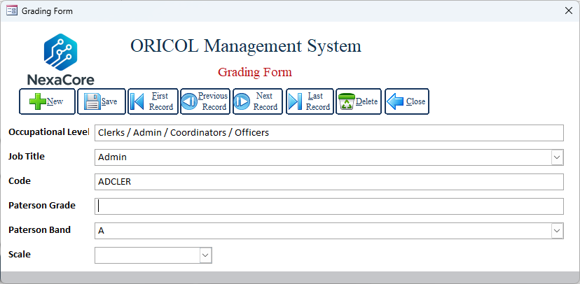
This must connect automatically with Job title
Insert two fields-Min salary and max salary
Max rate (R)
Max rate (R)

Slide 30
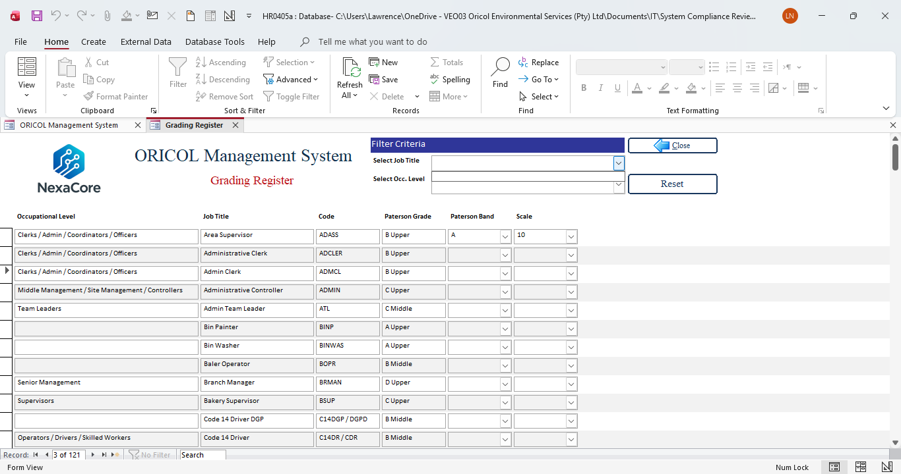
Job title not pulling through from this list
Colour incorrect
Max rate (R)
Max rate (R)
Insert two columns -Min salary and max salary

Slide 31
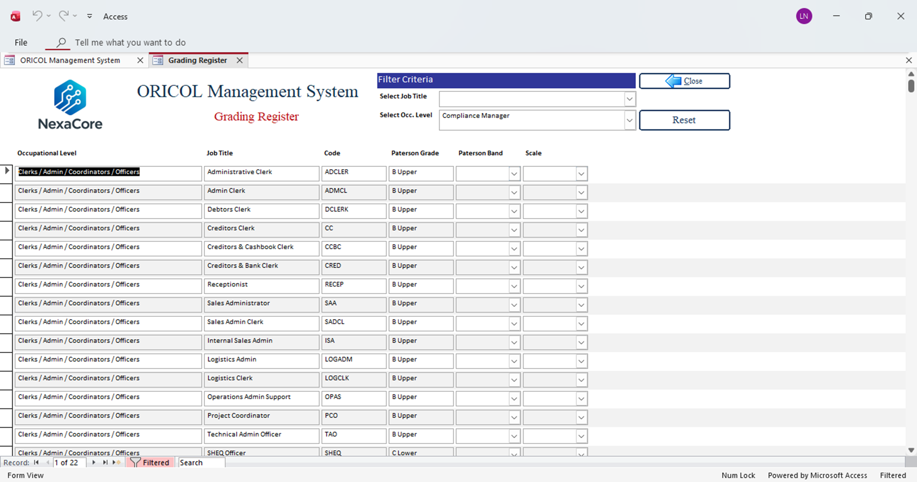
This data from the register is not in the form directory, so we can't change details- flow was supposed to be from form to register

Slide 32
Evaluation

Slide 33
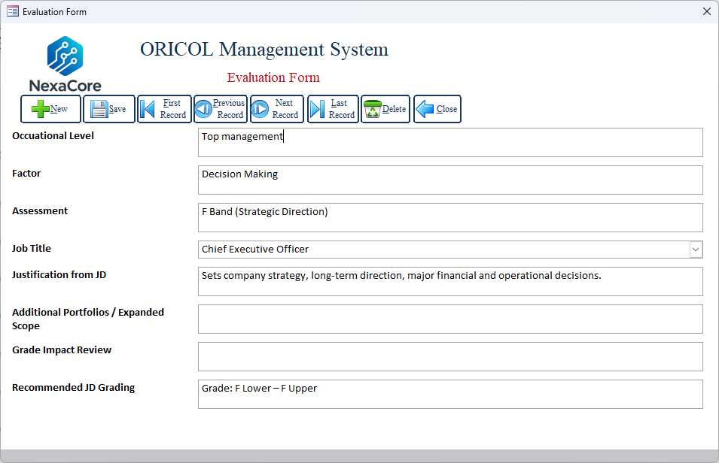
Add Search function per Job Title
No drop down from source
Move Job title to the top and data swop – occupational level with Job title
Add 6 Factors
CEO approval
Yes /No
Plan/Notes
…..

Slide 34
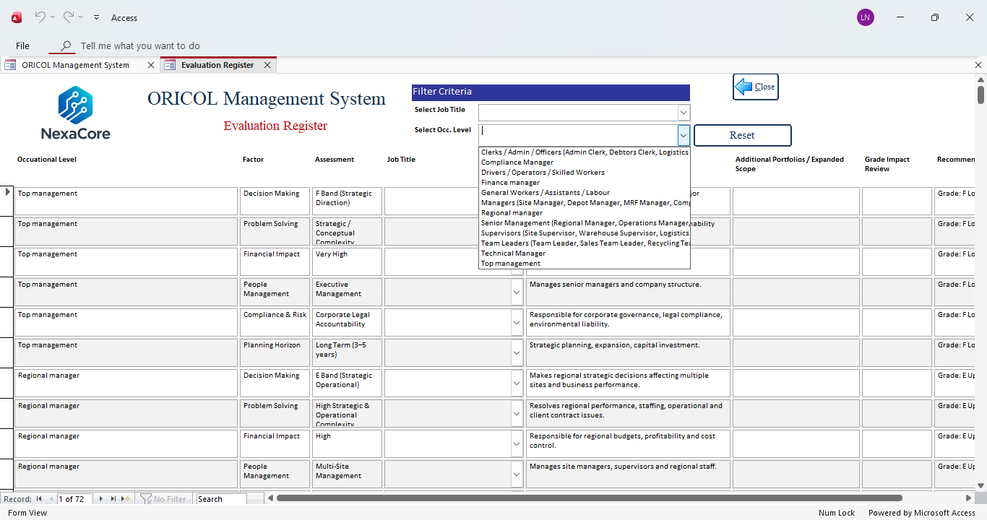
This filter is pulling two data sets- Job Title and Occ Level and the top Job title is pulling nothing.

Slide 35
New employee take on

Slide 36
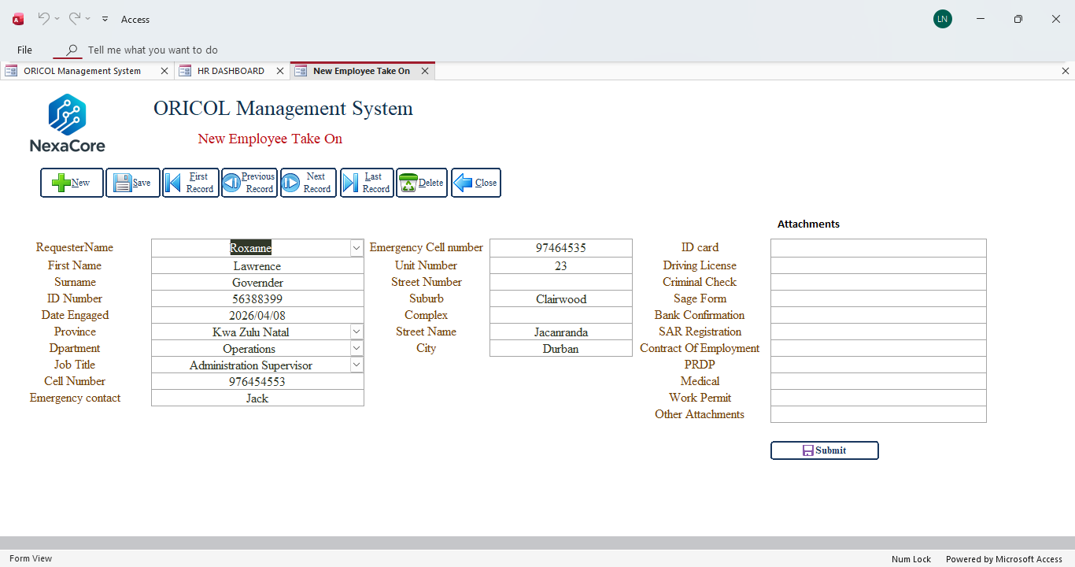
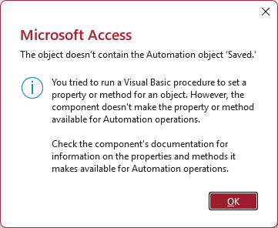
When save is clicked this is what appears. make it function
Other attachments doesn’t work to upload

Slide 37
Employee exit form

Slide 38
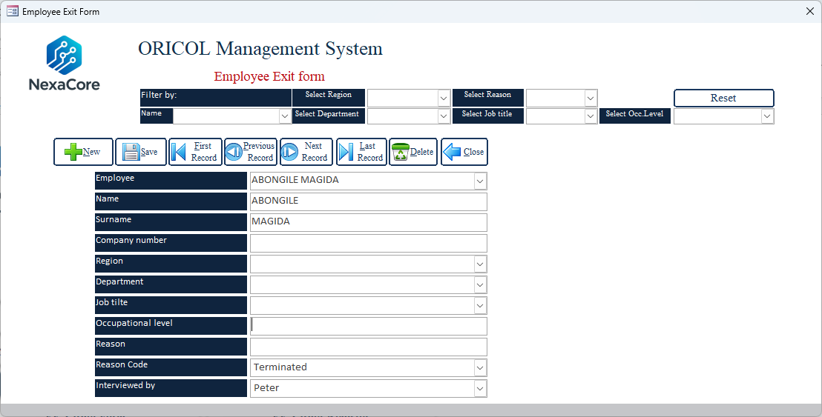
Delete
Company number not coming up- only name and surname
All this should be auto populate, now not selecting

Slide 39
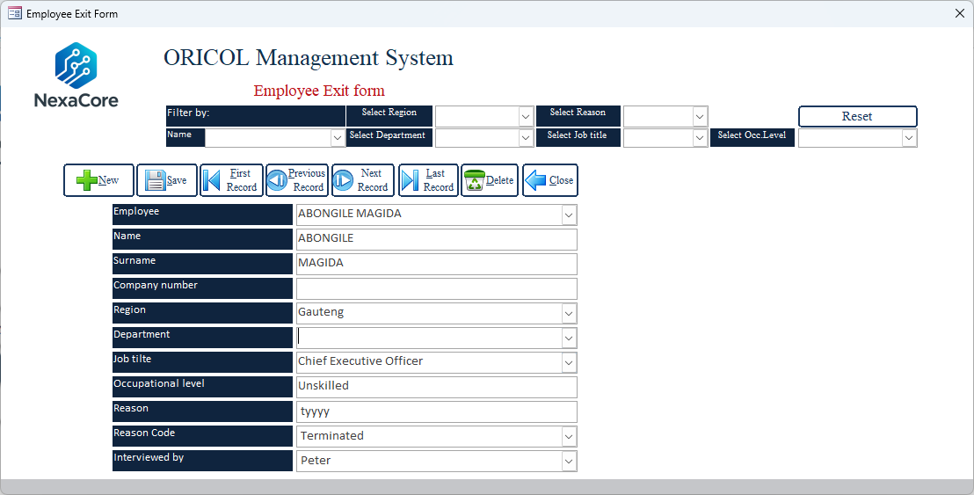
All these filter was supposed to be in the register, pleas delete.
Employee code- not appearing from employee details
The drop down doesn’t select BUT The deta pulled from employee details when I added it
The drop down doesn’t select

Slide 40
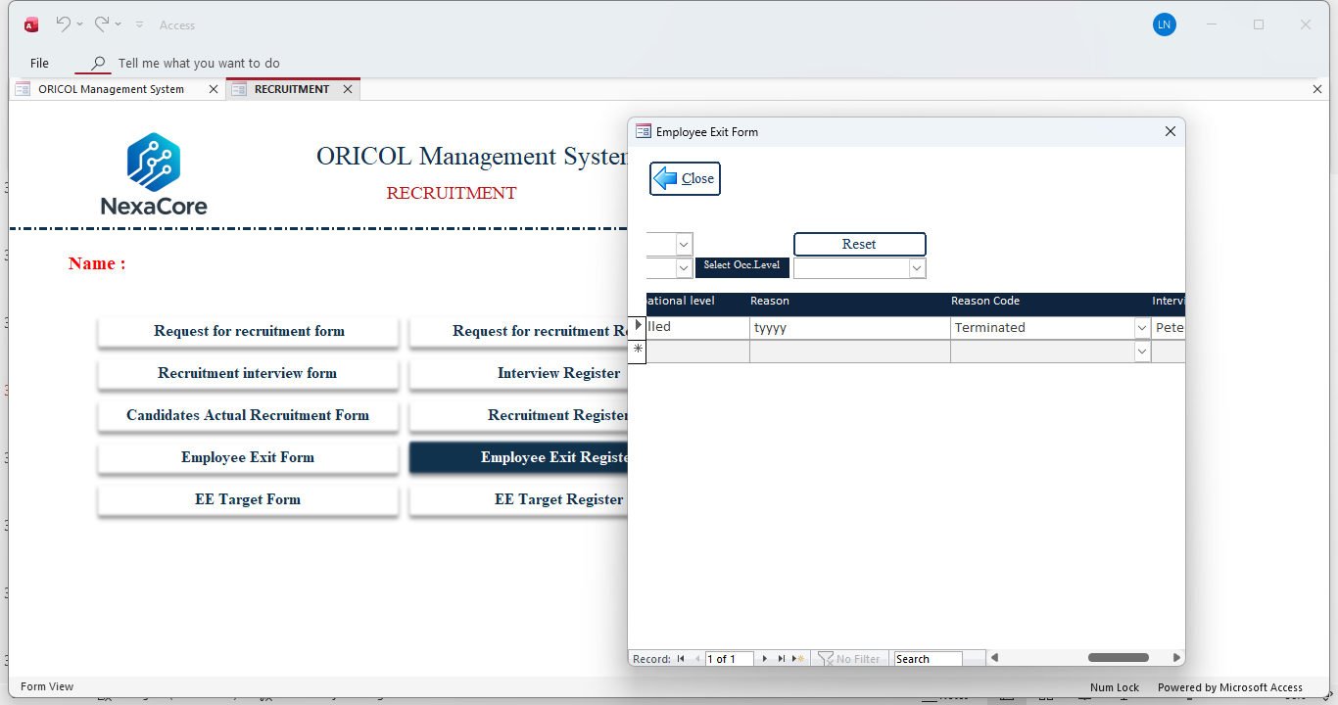
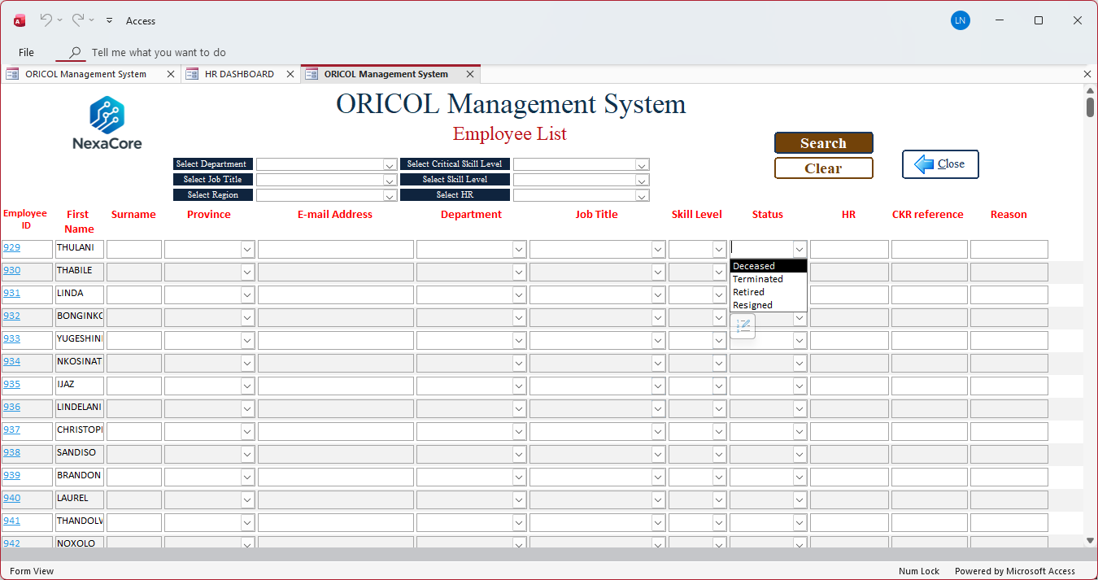
Once employee is Exit employment, it must appear on the employee register and show in employee details under HR

Slide 41
Leave form

Slide 42
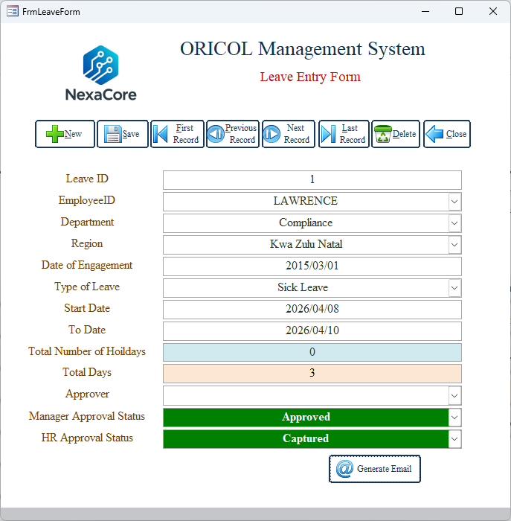
Add/ weekend
Approver not functioning-list of approver from HR
These two must be deleted but appear on register

Slide 43
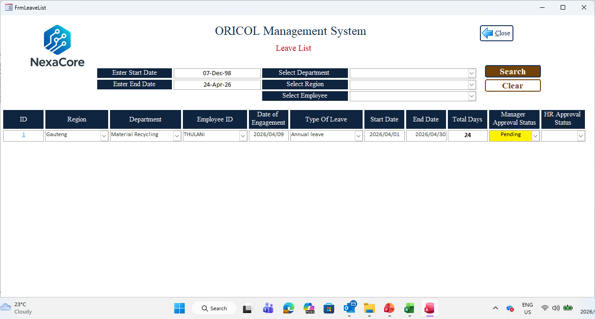
Can a link be placed that shows a calendar year of leave taken per employee selected

Slide 44
Expense -Claim approval

Slide 45
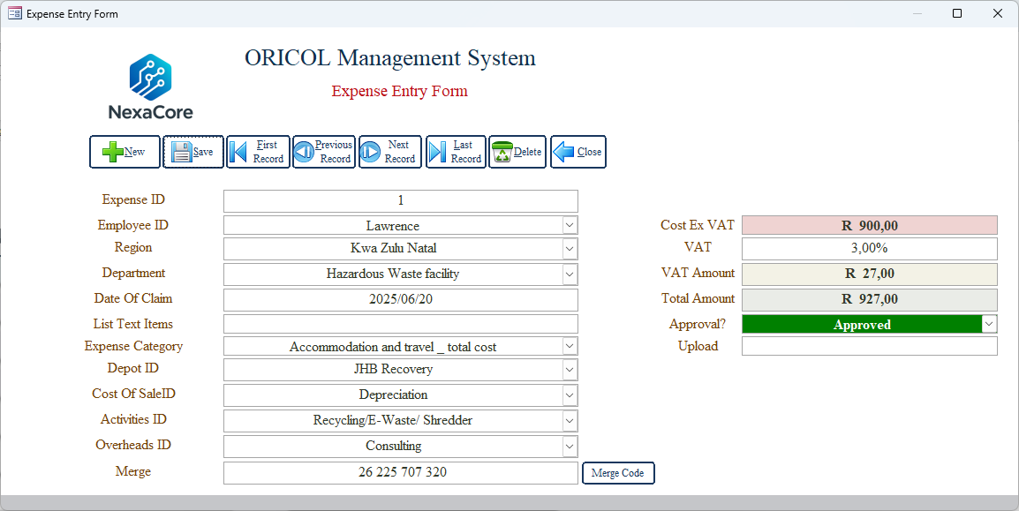
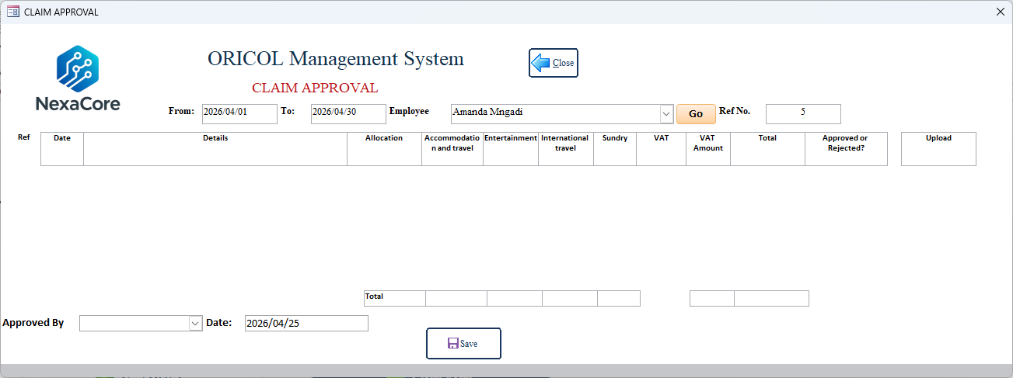
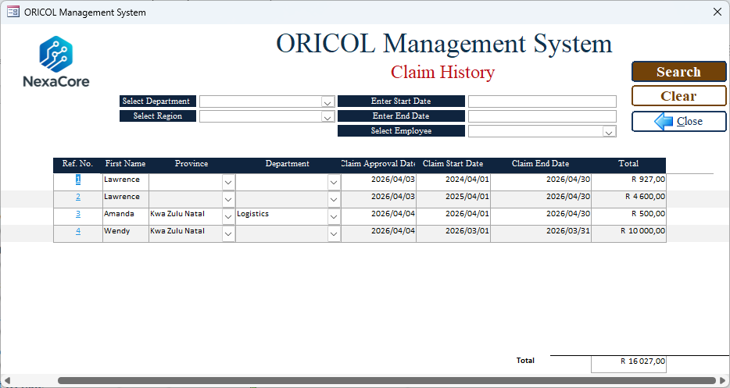
You can have multiple of this in one claim
This sheet is represented in one line here

Slide 46
Approve or /Correct or delcline
Approver

Slide 47
Once approved – by approver – instruct finance to pay (add column field)

Slide 48
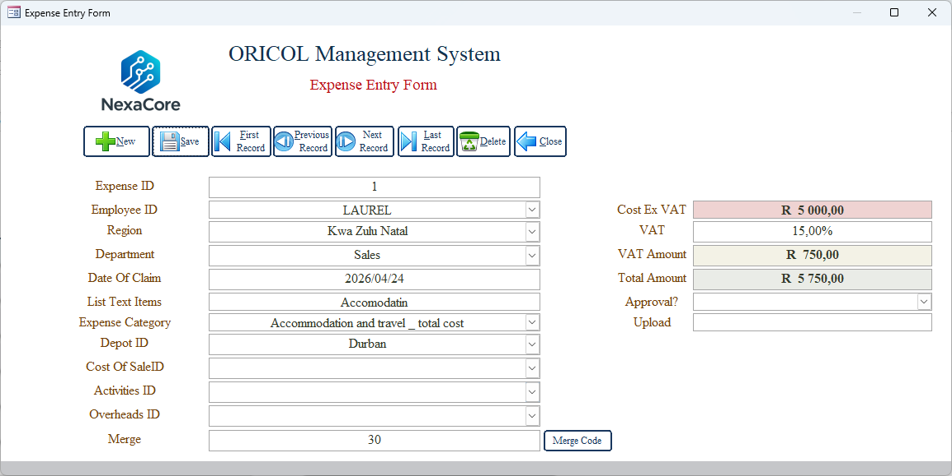
Claim History
Code must appear as I select , not all selection will apply-this waits for me to select all

Slide 49
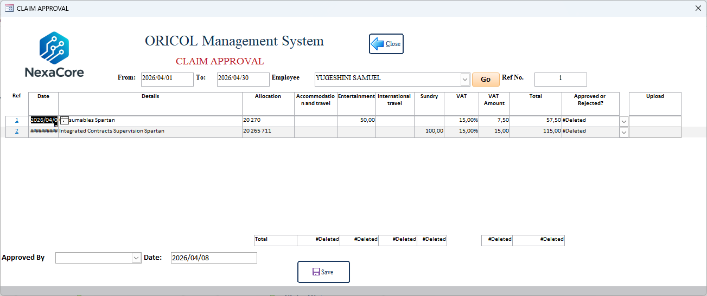
Columns not adding

Slide 50
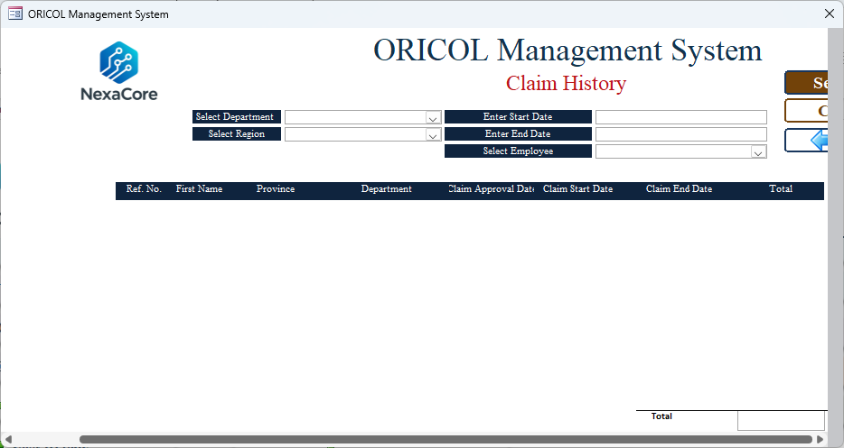
Claim history not functional

Slide 51
Login

Slide 52
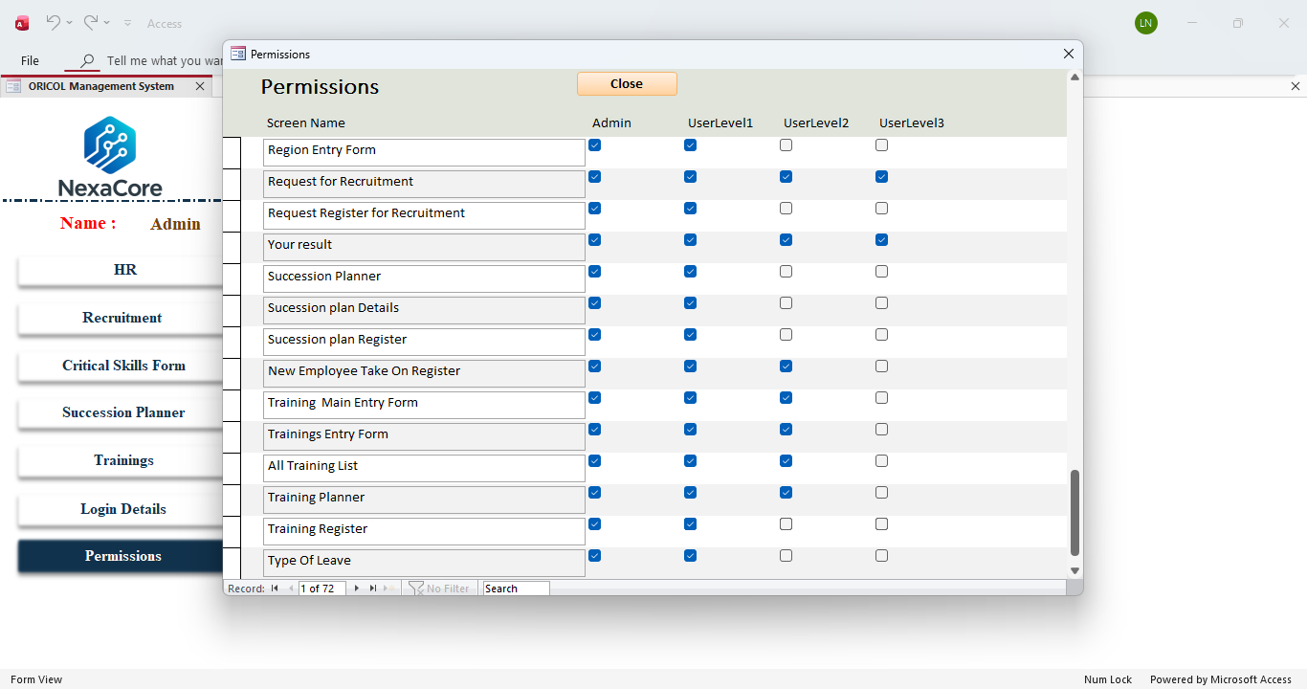
Take up test – not here in permissions

Slide 53
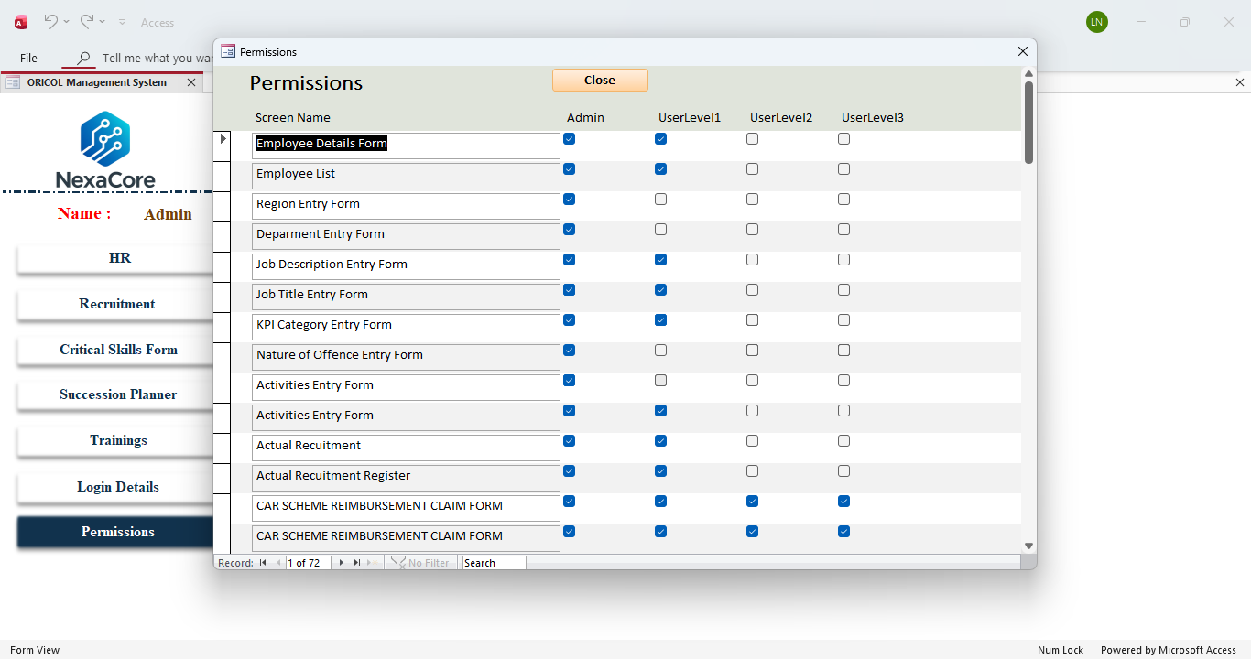
Login Details and permissions not protected don’t appear on list
Duplicate label

Slide 54
Training

Slide 55
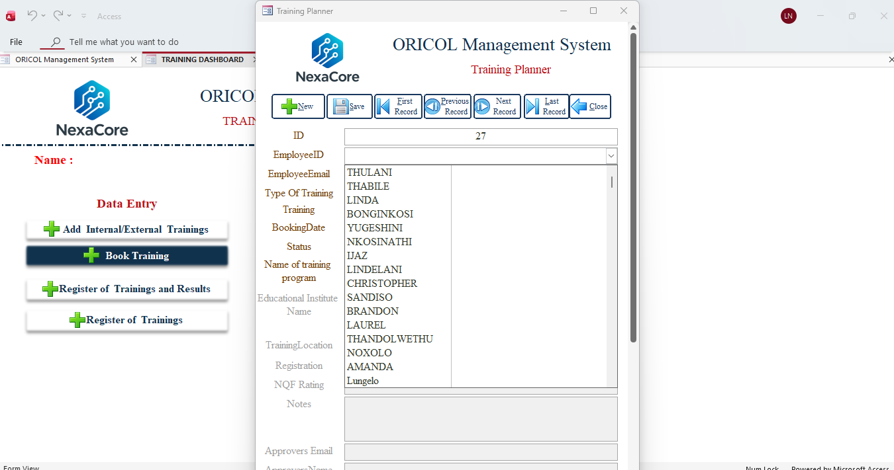
Search function needed for name or alphabetical order- can't find names

Slide 56
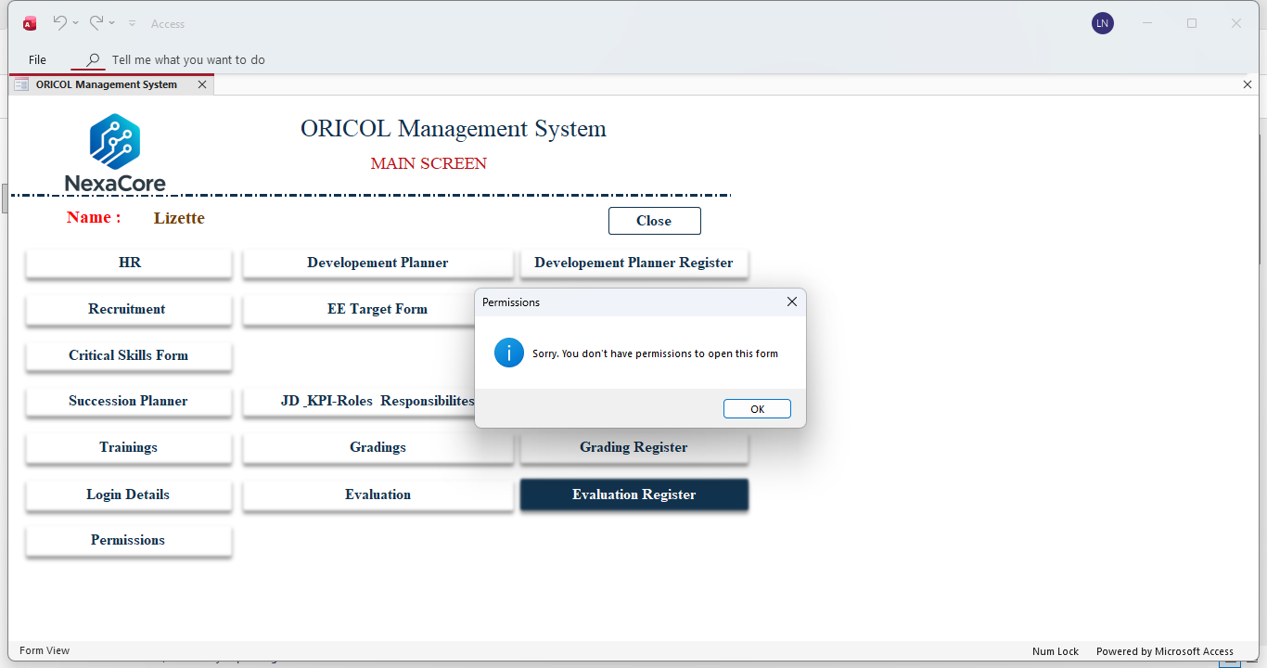
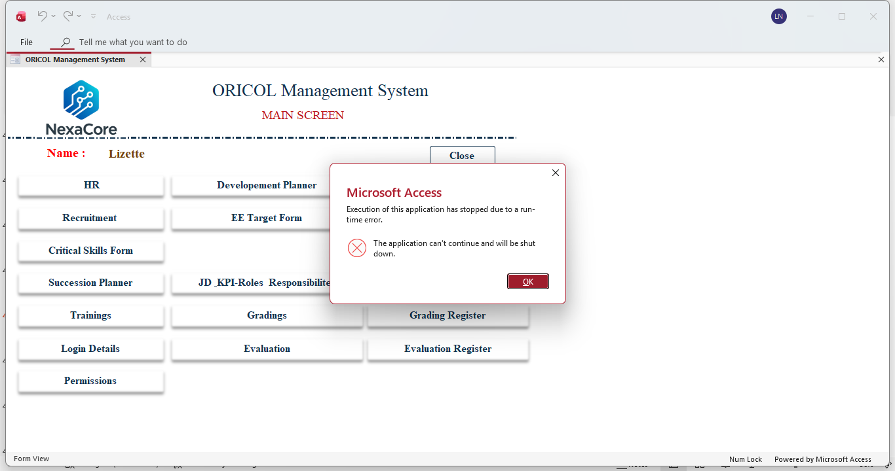
When a user doesn’t have access, this is what it say- which is okay BUT when you click okay the runtime error op up appears and when you click okay it closes the entire app

Slide 57
Each – user must access to their profile and task including training:
Training courses allocated to them
Take a test
See results

Slide 58
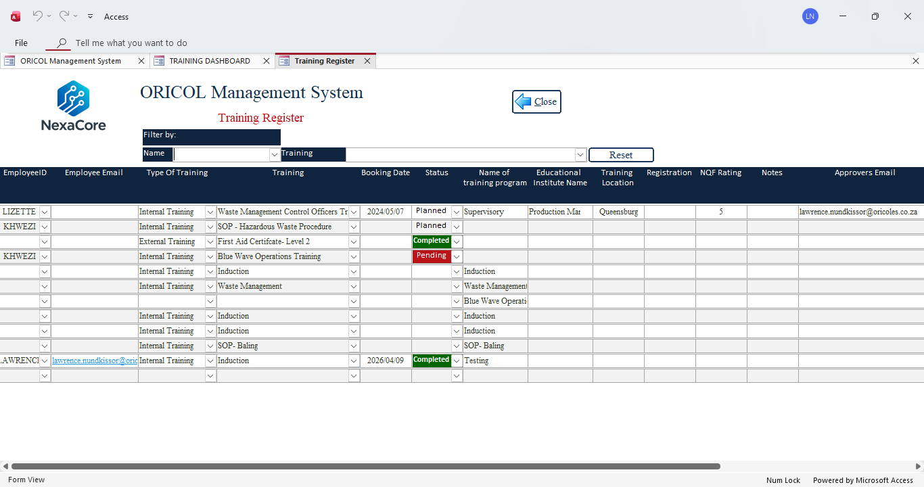
Filter “type of training” missing

Slide 59
JD –Kpi

Slide 60
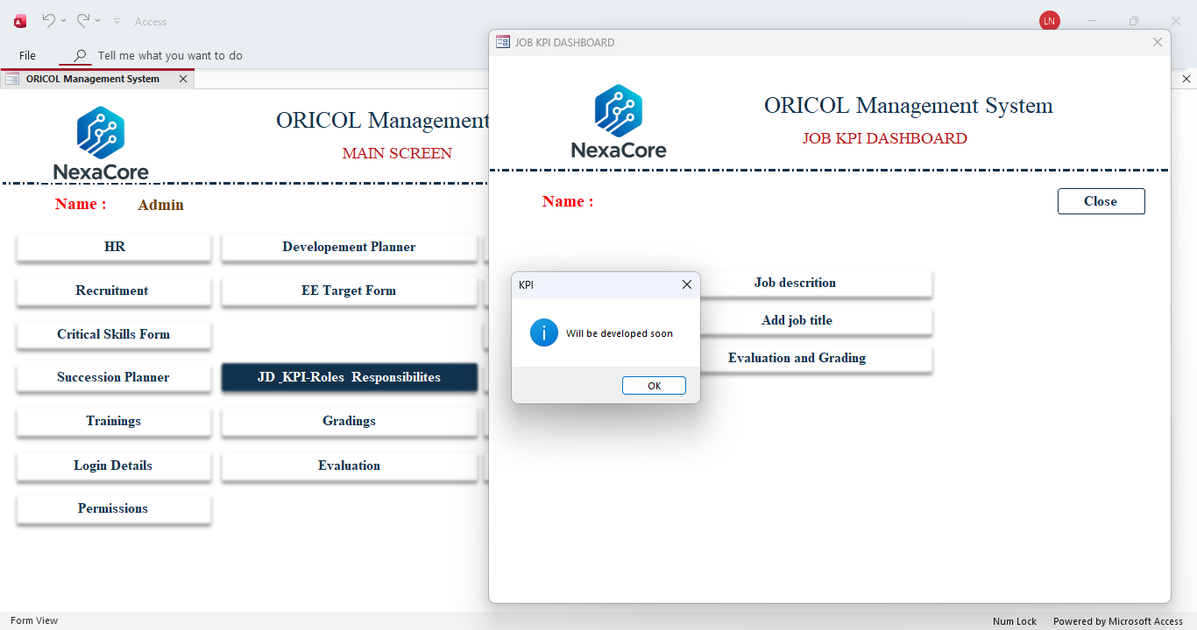
remove

